Slide 1

Reaching the Right People
Targeting Challenges in Social Protection Systems
Evidence and Methods from Low and Middle Income Countries
October 2025

Slide 2

Overview
The Targeting Concept and Theory
Defining the Need, Possible Social Maximands and Modes
The Targeting Debate and Challenges
Universal vs. targeted approaches to social protection and their trade-offs
Targeting Approach and Methods in identifying benefecianiries
Income-based targeting, proxy means testing, geographic targeting, community-based targeting, categorical
targeting, and self-targeting
Evidence from Targeting Experiments
Empirical findings on targeting effectiveness, inclusion and exclusion errors, and implementation challenges
Policy Implications and Future Directions

Slide 3
Targeting Concept and Theories

Slide 4
Targeting
Targeted welfare programs are usually justified by the argument that it is our responsibility to help the needy.
But who are the needy?
Requires a socially accepted definition of need
And what is the best way to find them and help them?
Requires a credible mechanism for identifying those whose needs can be most effectively assuaged by the resources available
And delivering to them.

Slide 5

Defining Need
$v\left(c_{i1},c_{i2},….c_{in}\right):is the social utility associated with family i$
consuming a vector${ c}_{i1},c_{i2},….c_{in}$ and assume standard concavity
Families are needy when the social utility is low
Note that we are already assuming anonymity (not $v_{i}$ )
Perhaps conditional on some characteristics (gender, historical discrimination)
There is a population of potentially needy, $i=1,2……m$
There is a budget of transfers of size 1 that can be given to the needy and the number of possible transfers is $m^{′}<m$
No a priori reason why the transfer amounts could not vary.

Slide 6
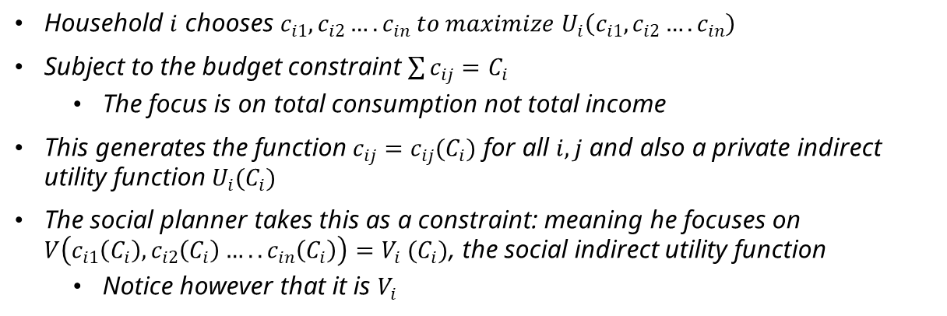
Wants and Needs
Household $i$ chooses $c_{i1},c_{i2}….c_{in} to maximize U_{i}\left(c_{i1},c_{i2}….c_{in}\right)$
Subject to the budget constraint $\sum{c_{ij}=C_{i}}$
The focus is on total consumption not total income
This generates the function $c_{ij}=c_{ij}(C_{i})$ for all $i,j$ and also a private indirect utility function $U_{i}(C_{i})$
The social planner takes this as a constraint: meaning he focuses on $V\left(c_{i1}\left(C_{i}\right),c_{i2}\left(C_{i}\right)…..c_{in}\left(C_{i}\right)\right)=V_{i} (C_{i})$, the social indirect utility function
Notice however that it is $V_{i}$

Slide 7

Different Possible Social Maximands
Social welfare maximization
maximize $\sum{V_{i}\left(C_{i}+1{.δ}_{i}\right)}$ where $δ_{i}$ is an indicator for being a beneficiary subject to the constraint that $\sum{δ_{i}=m′<m. }$
Focus on marginal social utility
“Rawlsian”
Ideally give benefits to everyone with $V_{i}\left(C_{i}\right)≤V_{min}$
Focuses on the level of social utility

Slide 8

Modes of Targeting: Consumption
Targeting consumption
When $u_{i}=u ∀i, V_{i}=V,$ in which case the rule is always to target those with the lowest values of $C_{i}$
With either of the social objectives
Otherwise
it is generally not optimal to target based on total consumption
The composition matters
And the two social objectives may lead to different targets
The poorest may not have the highest marginal utility

Slide 9

A Special Case
$u_{i}\left(c_{i1},c_{i2}….c_{in}\right)=u\left(c_{i1},c_{i2}….c_{in−1}\right)+u_{in}\left(c_{in}\right).$
$v=v(c_{i1},c_{i2}….c_{in−1}$)
The last good is a bad from the social point of view
The household chooses $c_{i1},c_{i2}….c_{in−1}$ to maximize $u\left(c_{i1},c_{i2}….c_{in−1}\right)$ subject to $\sum_{1}^{n−1}{c_{ij}=C_{i}−c_{in}}$ which gives us:
$c_{ij}=c_{ij}(C_{i}−c_{in}$)
This gives us a social indirect utility function $V(C_{i}−c_{in}$)
Assuming we observe both $C_{i}$ and $c_{in}, focus on$consumption net of “waste”
On the other hand, let $v=v(c_{i1},c_{i2}….c_{in−1}$, $c_{in}$), with $\frac{dv}{dc_{in}}<0.$
In this case $V=V(C_{i}−c_{in}\text{,}{ c}_{in}\text{)}$
Greater $c_{in}$ has two conflicting effects

Slide 10

Modes of Targeting: Self-Reports
Targeting based on self-reports:
The slope ($U_{i}\left(C_{i}+1\right)−U_{i}(C_{i})$)
The level ($U_{i})$
Assume that self-reports are not strategic
Big issue of course
If${ U}_{i}=U and V=aU+b,$ then targeting based on self-reports will lead to the targeting the social planner wants
Not typically otherwise

Slide 11

Modes of Targeting: Community
Targeting based on community reports
Who will benefit most from getting benefits?
Perhaps closest to targeting on $V\left(C_{i}+1\right)−V(C_{i})$
Rank families by poverty level
Perhaps closest to targeting on $V\left(C_{i}\right)$
However, we don’t directly observe the $V(C_{i})$ the community is using
Could be $V_{com}=V(C_{i}−c_{in}\text{,}{ c}_{in}\text{)}$ or $V_{com}=V(C_{i}\text{,}a\text{)}$ , where $a$is a characteristic (ethnicity, connection to elites)
May not be the greater society’s preference

Slide 12

What if we don’t observe…?
We might want to correct for the gap between community preferences and social prferences
But there is no reason to assume that we know $n or a$ for each community
If we only observe $C_{i}$ we might discover that
$V_{com} \left(C_{i}+1\right)−V_{com}\left(C_{i}\right)>V_{com}\left(C_{j}+1\right)−V_{com}(C_{j})$ but
$V_{com} \left(C_{i}\right)>V_{com}(C_{j})$
Because even though household $j$ is poorer, they are expected to spend more of an extra dollar on bads
Can try to look for certain specific types of preferences (elite capture, rewarding diligence, helping widows)
And perhaps correct for it

Slide 13

Modes of Targeting: Self-Selection
Self-targeting based on costly effort
Targets on $U_{i}\left(C_{i}+1\right)−U_{i}\left(C_{i}\right)$
Only those who have $U_{i}\left(C_{i}+1\right)−U_{i}\left(C_{i}\right)≥$ $e_{i}$ get it
No reason why $e_{i}$ would be constant
Additional variation on who gets it induced by variation in $e_{i}$
The correlation between $e_{i}$ and $U_{i}\left(C_{i}+1\right)−U_{i}\left(C_{i}\right)$ also plays a role
Not particularly on $U_{i}\left(C_{i}\right)$ (unless for example $U_{i}\left(C_{i}\right)=U,$and $U$ is concave)
Potentially quite different from targeting $V\left(C_{i}+1\right)−V(C_{i})$ or $V(C_{i})$

Slide 14

In other words
Each approach to targeting is actually addressing a different notion of need and not necessarily what the social planner wants to focus on
Unless we have very good reason to believe that $U_{i}=V$
Or that the community has the same preference as the social planner
Using data from Indonesia we find wide divergences in rankings based on
$$V_{com} \left(C_{i}+1\right)−V_{com}\left(C_{i}\right)$$
And
$V_{com}\left(C_{i}\right)$

Slide 15
The Targeting Debate and Challenges

Slide 16
The Targeting Debate
Should governments provide assistance universally or target specific groups?
Arguments for Targeting
Arguments for Universalism
Inclusion: Eliminates exclusion errors that leave out vulnerable households
Social cohesion: Avoids stigmatization and social divisions from targeting
Administrative simplicity: Reduces costs and complexity of implementation
Cost efficiency: need them most
Poverty impact:
Concentrates limited resources on those who
Potentially larger per-beneficiary benefits
for greater poverty reduction
Equity: Directs resources to disadvantaged groups to address inequality
The fundamental question of whether to target social assistance or provide universal benefits remains a subject of ongoing debate.
In LMICs, lower tax collection rates and competing needs in health, infrastructure, and education constrain budgets. This increases pressure to target assistance effectively while maintaining political legitimacy and fairness across diverse populations.

Slide 17
Defining the Target
Targeting strategies must align with specific program objectives and poverty contexts. Different approaches serve different populations and goals, from immediate poverty alleviation to long-term development outcomes.
01 02
The Very Poor
Hundreds of millions living on less than $2.15 per day globally, requiring approaches that identify low consumption or income levels
Poverty Trap Households
Families where assistance can enable investments in productive assets or child development to break intergenerational poverty cycles
03
04
Unable to Work
Individuals with disabilities, mental health conditions, or elderly requiring long-term assistance for basic living standards
Nutrition & Development Focus
Programs targeting improvements in nutrition or child development, which may require different criteria than income-based approaches

Slide 18





Targeting Challenges in LMIC
The problem of targeting is particularly severe in developing countries:
Pervasive self-employment and informal employment means most people's income isn't third- party reported
Limits use of the tax code for redistribution → many targeting tools from US won't work (so, no income- based means testing,)"
High income volatility makes point-in-time
assessments less reliable
Universal programs are substantially more costly relative to targeted programs (Hanna and Olken 2018)
Limited administrative data systems for verification

Slide 19
Targeting Approaches and Methods

Slide 20

Income Targeting: Means Testing
Means testing involves directly verifying household income or wealth to determine eligibility for social assistance
programs.
Definition & Approach
Disadvantages
Depends on reliable information on income, which is often unavailable in developing countries
Can create work disincentives as earning more may lead to benefit loss
Difficult to verify in contexts with high informality May miss households with volatile incomes
Means testing uses verified income or wealth information from official records or declarations to determine eligibility. It is the most direct approach to targeting but requires reliable income data.
Advantages
Strong targeting accuracy when reliable income data is available
Direct measurement of welfare rather than proxies
Clear and transparent eligibility criteria

Slide 21




Income Targeting :Three Essential Steps
Effective income-based targeting requires three interconnected systems to identify eligible beneficiaries and deliver benefits efficiently:
1 2 3
Establish Unique Identifiers
Create a system that uniquely identifies each
person or household in the population
Link Income Information
Match reliable income or wealth information to
each identifier to assess eligibility
Create Distribution Systems
Develop mechanisms to authenticate recipients
and deliver benefits securely
LMIC Challenge:
Many countries lack comprehensive identification systems, particularly for rural populations
LMIC Challenge:
70-90% of households operate outside formal tax systems
LMIC Challenge:
Limited financial infrastructure and challenges in preventing fraud

Slide 22



Geographic Targeting: Concept and Application
Geographic Targeting Approach
Geographic targeting allocates resources based on the spatial concentration of poverty, directing benefits to all residents in selected geographic areas rather than identifying individual households (Baker and Grosh 1994; Elbers et al. 2007
Spatial Poverty Mapping
Uses census data, household surveys, and satellite imagery to identify geographic areas with high poverty concentrations
Administrative Simplicity
Requires significantly less administrative capacity than household-level
targeting, suitable for countries with limited infrastructure
Community Cohesion
Avoids creating divisions within communities by treating all residents equally, potentially increasing program acceptance
Key Limitation: Intra-regional Heterogeneity
Geographic targeting inevitably includes some non-poor households in targeted areas while excluding poor households in non-targeted areas
Optimal Application
Most effective when poverty is highly spatially concentrated and when used as a first-stage filter before applying other targeting methods
"Geographic targeting can be particularly effective when poverty is spatially
concentrated and administrative capacity is limited."

Slide 23

Geographic Targeting: Tradeoffs and Considerations
While geographic targeting offers administrative simplicity, it involves important tradeoffs that policymakers must consider when designing social protection programs.
Accuracy vs. Administrative Simplicity
Geographic targeting is administratively simpler than household-level targeting but introduces both inclusion errors (benefits to non-poor in targeted areas) and exclusion errors (no benefits to poor in non-targeted areas)
Data Currency and Reliability
Geographic targeting relies on periodic census or survey data that may become outdated, particularly in rapidly changing environments or post- crisis situations
Geographic Unit Selection
Smaller geographic units (e.g., villages) improve targeting accuracy but increase administrative costs and complexity compared to larger units (e.g., districts or regions)
Migration Effects
Geographic targeting may inadvertently create incentives for migration to targeted areas, potentially distorting settlement patterns and straining local resources
Political Economy Considerations
Geographic targeting may face political resistance if it concentrates resources in specific regions, potentially creating perceptions of favoritism or neglect

Slide 24



Proxy Means Test (PMT)
PMT is a statistical method that uses observable household characteristics to predict welfare levels and identify eligible beneficiaries.
PMT Implementation Steps
Common PMT Variables
Housing: Construction materials, floor type, roof type Utilities: Electricity access, water source, sanitation
1
Data collection: Gather information on household characteristics (assets, housing quality, demographics)
2
Model development:
Use regression analysis or other statistical method
Assets:
to identify variables that predict consumption/income
Score calculation: Apply weights to household characteristics to generate welfare scores
Threshold setting: Establish cutoff points for program eligibility based on budget constraints
Verification: Validate results through community input or other mechanisms
Ownership of durable goods (TV, refrigerator, vehicles)
3
Demographics:
Household size, dependency ratio, education levels
4
Employment: Occupation types, sector of employment
5

Slide 25





PMT Targeting: Advantages and Challenges
Proxy Means Testing (PMT) offers a practical compromise between targeting accuracy and administrative feasibility in contexts where direct income verification is
difficult, but comes with its own set of challenges.
Key Advantages Key Challenges
Observable Verification
Uses easily observable household characteristics, reducing the need for complex income documentation and tend to capture the more permanent component of household income
Prediction Errors
Statistical models inevitably produce both inclusion and exclusion errors,
Informal Sector Coverage
Effectively identifies poor households in informal economies where income records are unavailable
Static Nature
PMT formulas capture household conditions at a specific point in time and may not reflect sudden shocks. Data collection typically occurs only every few years
Reduced Manipulation
More difficult to manipulate than self-reported income, as proxy variables are harder to misrepresent
Transparency Issues
Complex scoring formulas can be difficult for beneficiaries to understand, potentially reducing program legitimacy

Slide 26
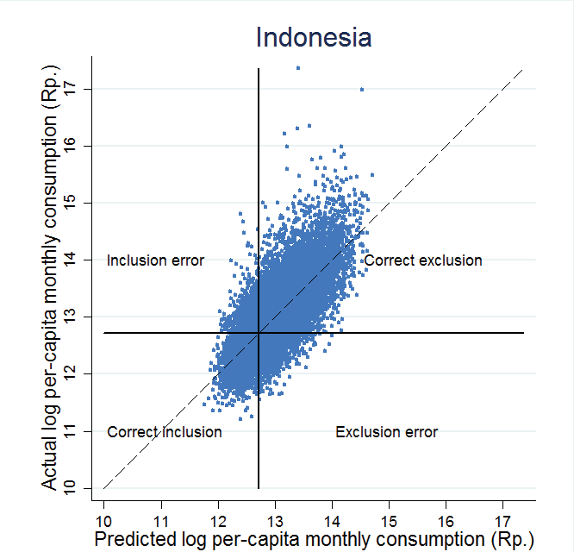
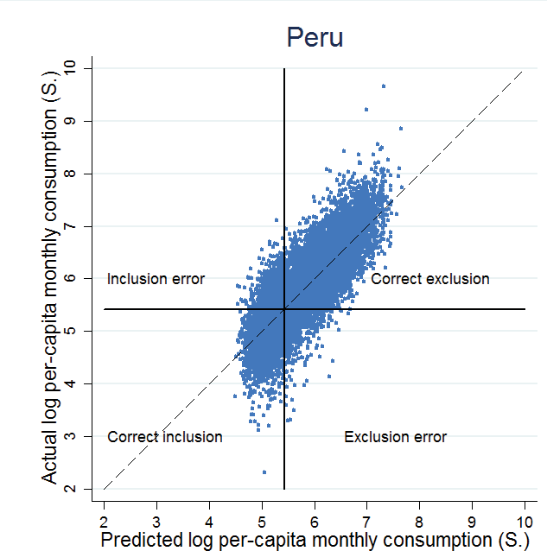
Proxy-means tests are imperfect
Source: Hanna and Olken (2018)

Slide 27






PMT Targeting: Data Collection Process
Effective Proxy Means Testing (PMT) requires systematic data collection on observable household characteristics that serve as reliable proxies for income or consumption levels.
Data Collection Workflow
Data Collection Challenges
Time and Resource Intensity
Household visits require significant time and personnel, especially in remote areas
Response Manipulation
Households may modify responses or hide assets if they understand targeting criteria
Enumerator Inconsistency
Different interpretations among enumerators can introduce systematic bias
1 | Questionnaire Design Develop standardized questionnaires capturing key proxy variables identified in the PMT formula
2 | Enumerator Training Train field staff on questionnaire administration and verification protocols
3 | Household Visits Conduct in-person visits to administer questionnaires and observe housing conditions
4 | Data Verification Implement spot checks and/or community validation to verify data accuracy
5 | Score Calculation Process collected data through the PMT formula to determine eligibility

Slide 28


Categorical Targeting
Categorical targeting provides benefits to individuals or households based on easily observable characteristics that are correlated with poverty or vulnerability, without directly measuring income or wealth.
Common Targeting Categories
Advantages and Limitations
Advantages
Simple to implement with low administrative costs
Transparent and easily understood eligibility criteria Avoids stigmatization associated with means testing Often enjoys strong political support and sustainability
Demographic Groups
Targeting based on age (children, elderly), gender (female-headed households), or disability status
Life-Cycle Vulnerabilities
Targeting based on specific life stages with heightened vulnerability (pregnancy, school-age children, retirement)
Limitations
High inclusion errors (benefits to non-poor within categories)
Potential exclusion of poor who don't fit selected categories
May require higher budget to achieve poverty reduction goals
Occupational Status
Targeting based on employment in specific sectors (agriculture, informal
sector) or unemployment status
Shock Exposure
Targeting based on exposure to specific shocks (natural disasters, conflict, displacement)

Slide 29


Self-Targeting
Self-targeting designs programs with features that encourage participation by the poor while discouraging the non-poor, allowing individuals to self-select into programs based on their
own assessment of costs and benefits.
Key Self-Targeting Mechanisms
Advantages and Limitations
Advantages
Eliminates need for complex administrative screening processes Reduces administrative costs of identifying beneficiaries Automatically adjusts to changing economic conditions
Avoids stigmatization associated with explicit means testing
Limitations
May exclude some poor individuals due to information barriers Can impose significant opportunity costs on participants
May create inefficiencies through work requirements
Time costs can represent significant opportunity costs for poor households
Work Requirements Programs requiring manual labor at minimum wage attract those with limited alternative income opportunities
Time Costs Requiring beneficiaries to wait in long lines imposes higher opportunity costs on those with higher incomes
Quality Differentiation Providing lower-quality goods that are less attractive to higher-income groups (e.g., subsidizing lower-quality staple foods)
Location-Based Access Placing service delivery points in areas predominantly inhabited by the poor, increasing access costs for the non-poor
Case Study: India's MGNREGA India's Mahatma Gandhi National Rural Employment Guarantee Act provides 100 days of manual labor at minimum wage to rural households, effectively targeting the poor through self-selection
Self-targeting mechanisms require actions that are costlier for richer households, such as long lines or collecting lower-quality goods. These approaches can screen out applicants less likely to need assistance while offering flexibility for households to seek help when needed.

Slide 30
Community-Based Targeting
Community-based targeting leverages local knowledge by empowering community members or local leaders to identify the most vulnerable households based on their understanding of
local poverty dynamics. Alderman 2002; Galasso and Ravallion 2005).
Implementation Process
Strengths and Limitations
Key Strengths
Local Knowledge Utilization
Leverages detailed community knowledge about household conditions
Contextual Adaptation
Adapts to local definitions of poverty that vary across regions
Community Ownership
Increases program legitimacy through participatory processes
Key Limitations
Elite Capture Risk
Potential for local power structures to influence selection
Social Tensions
May create community conflicts through the selection process
Community may use different criteria than program intends
1 | Community Mobilization Engage with community members to explain program objectives and selection process
2 | Selection Committee Formation Establish representative committees including diverse community members
3 | Poverty Criteria Definition Define locally relevant poverty indicators and vulnerability criteria
4 | Beneficiary Identification Committees identify potential beneficiaries based on agreed criteria
5 | Public Validation Present selected beneficiaries for community validation and appeals

Slide 31






Community Based Targeting: Challenges and Mitigation
While community-based targeting leverages valuable local knowledge, it faces several implementation challenges that must be addressed to ensure effective and equitable beneficiary
selection.
Key Implementation Challenges Mitigation Strategies
Elite Capture
Local power structures may influence selection processes, leading to favoritism toward
relatives or political allies
Committee Representation
Selection committees may not adequately represent marginalized groups, leading to their systematic exclusion
Inconsistent Criteria
Different communities may apply varying standards of poverty, creating horizontal inequities across program areas
Transparent Processes Conduct selection in public meetings with clear documentation of decisions and criteria
Diverse Committee Composition Ensure committees include representatives from different social groups, including women and marginalized populations
Standardized Guidelines Provide clear, standardized poverty criteria while allowing for contextual adaptation
Hybrid Approaches Combine community targeting with other methods (PMT, categorical) to create checks and balances

Slide 32
Emperical Evidence From Targeting Experiments

Slide 33

Field Experiment 1: Comparing PMT, Community and Hybrid Method
To evaluate different targeting methods, a randomized experiment was conducted across 640 villages in Indonesia:
PMT Treatment
Standard proxy-means test using statistical formula based on household assets and characteristics to predict consumption. Households ranked by PMT score.
Experimental Design
640 villages randomly assigned to treatments Each village received a quota of beneficiaries Baseline and follow-up surveys conducted
Consumption data collected to measure targeting accuracy Satisfaction surveys to assess community perceptions
Community Treatment
Community meetings where residents ranked households from poorest to richest. Facilitators guided the process to ensure broad participation and minimize elite capture.
Key Metrics: Targeting accuracy (inclusion/exclusion errors), satisfaction with targeting process, elite capture, and cost- effectiveness were measured to compare the different approaches.
Hybrid Treatment
Community ranks households as above
Households with lowest ranking up to 1.5 x village quota are surveyed with PMT
questionnaire
Households with lowest PMT score up to village quota receive benefits
Source: Alatas et al. "Targeting the Poor: Evidence from a Field Experiment in Indonesia"

Slide 34
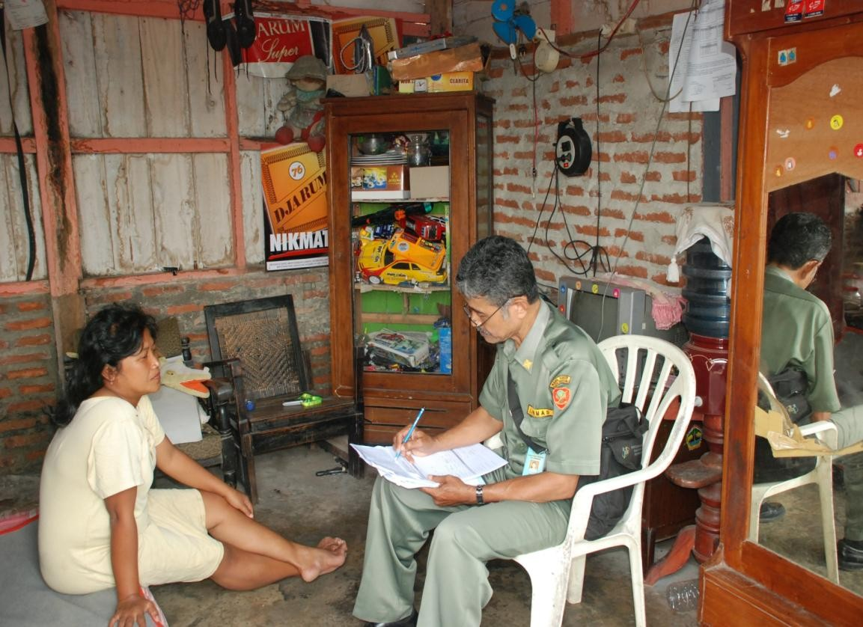
A PMT interviewer asks a household member about their
housing and other characteristics

Slide 35
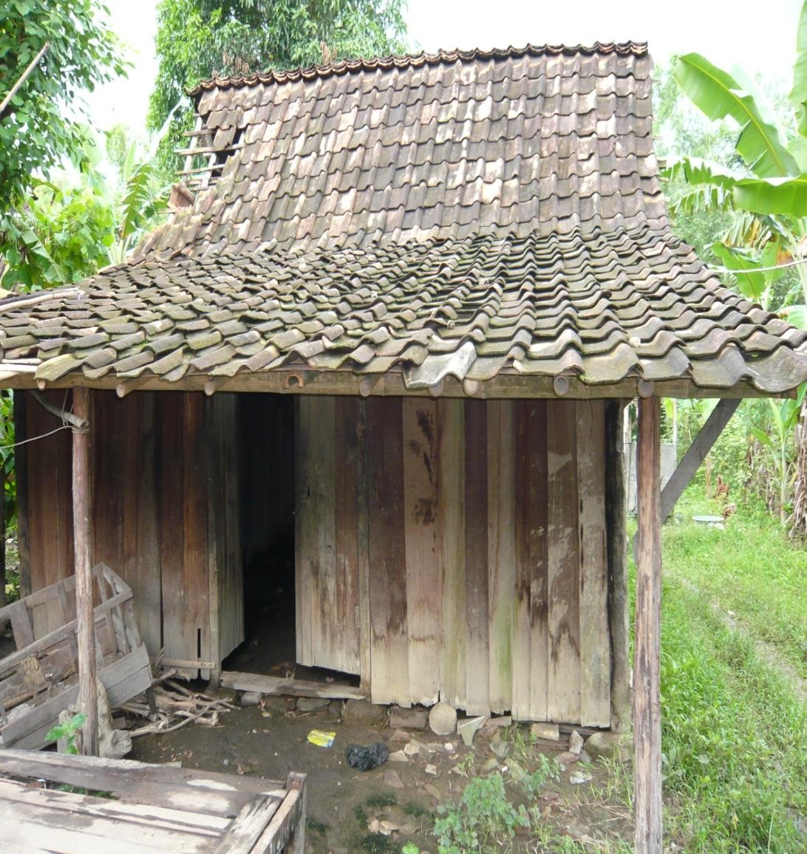
Households with low quality roof, walls and floor are likely
to score as poor with PMT

Slide 36
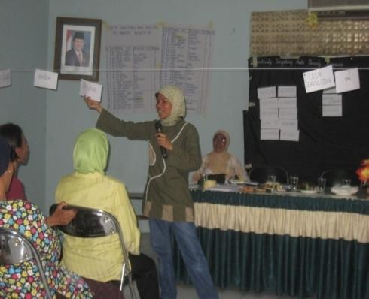
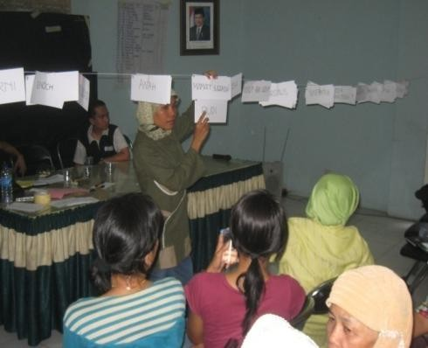
Community ranking of households was done in a carefully designed and facilitated process
1a. Hamlet leader invites community elite to day/night meeting
1b. Hamlet leader invites full community to day/ night meeting
2. Facilitator holds broad discussion on concept of
poverty
4. First two households are ranked
6a. Elite decides whether household is more or less poor already ranked household
3. Stack of cards for each household
5. Facilitator announces next household to be
ranked
6b. Community decides whether household is more or less poor already ranked household

Slide 37
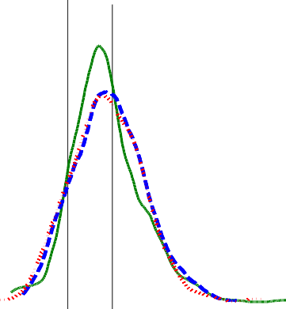

PMT had the lowest rate of mistargeting overall, but
community better identified the very poor...
Mistargeting
Beneficiaries
MISTARGET_{ivk}= α + β₁COMMUNITY_{ivk} + β₂HYBRID_{ivk} + γ_{k} + ε_{ivk}
Sample: | Full population
Community treatment | 0.031*
 | (0.017)
Hybrid treatment | 0.029*
 | (0.016)
Observations | 5753
Mean in PMT treatment | 0.30
Mistargeting: (1) Households ranked lower than the village quota cut-off who did not receive transfer; (2) Households ranked higher than the village quota cut-off who did receive transfer
Using the PPP$2 per day per-capita expenditure cutoff, 3 percentage point (or 10 percent) increase in mistargeting in community and hybrid over the PMT
PMT centered to the left of community methods
—better performing on average
However, community methods select more of the very poor (those below PPP$1 per day)

Slide 38
Moreover, satisfaction with the outcomes is higher community targeting than PMT
Community Satisfaction
 | Is the method applied to determine the targeted households appropriate? (1=worst,4=best) | Are you satisfied with P2K08 activities in this sub-village in general? (1=worst,4=best) | Are there any poor HH which should be added to the list? (0=no, 1 = yes) | Number of HH that should be added from list | Number of HH that should be subtracted from list
Community treatment | 0.161*** | 0.245*** | -0.189*** | -0.578*** | -0.554***
 | (0.056) | (0.049) | (0.040) | (0.158) | (0.112)
Hybrid treatment | 0.018 | 0.063 | 0.020 | 0.078 | -0.171
 | (0.055) | (0.049) | (0.042) | (0.188) | (0.129)
Observations | 1089 | 1214 | 1435 | 1435 | 1435
Mean in PMT treatment | 3.243 | 3.042 | 0.568 | 1.458 | 0.968
Comparing Methods | Comparing community to PMT
 | Fewer complaints in comment box ▪ Sub-village head more likely to think Fewer complaints to sub-village head ^{programme appropriate, that} community happy, less likely to think Facilitators report less problems _{households missing from list} More likely to distribute in community _{▪ Hybrid less effective than} ^{meeting than door-door} community but higher than PMT

Slide 39

Community Targeting Does a Better Job Matching Local Welfare Metrics
Communities may have a different concept of poverty: PMT correlates more highly to consumption, but community to household self-assessments
 | Consumption (rg) | Community survey ranks (rc) | Subvillage head survey ranks (re) | Self-assessment (rs)
Community treatment | -0.065** (0.033) | 0.246*** (0.029) | 0.248*** (0.038) | 0.102*** (0.033)
Hybrid treatment | -0.067** (0.033) | 0.143*** (0.029) | 0.128*** (0.038) | 0.075** (0.033)
Observations | 640 | 640 | 640 | 637
Mean in PMT treatment | 0.451 | 0.506 | 0.456 | 0.343
Source: Alatas et al (2012)

Slide 40
Elite Capture Analysis
There is no evidence that elites select family or relatives, although benefit levels in the first experiment were low...
Elite capture was tested for:
Half of villages had community elites only choose beneficiaries
Half of villages invited the whole community to a meeting
Important Context:
Benefit levels were low Beneficiaries received Rp.30,000
Elites may have greater incentive to capture process if higher benefits
No evidence of elite capture was found:
No difference in mistargeting outcomes
Elite households and those relatives less likely to be selected, regardless of actual consumption levels

Slide 41

CCT Program Self Targeting Experiment
PMT-Community Hybrid
Village quotas set with geographic targeting
2008 PMT listing of poor households sets 50 percent of quota Community can add the other 50 percent from the poorest
households not currently included
On-demand Application
Program and targeting process are heavily socialised Anyone can apply, but must be interviewed with a PMT
questionnaire
Households with lowest PMT scores up to village quota will be
visited for verification
The second experiment is being conducted in conjunction with the PKH expansion
PKH is the conditional cash transfer program
Very poor households with pregnant women, infants and young children, and school-aged children, receive cash transfers conditional on maternal and child health behaviors and school enrolment and attendance
Transfer levels are high, being between Rp.600,000 and Rp.2,200,000 per year
It is testing two different methods

Slide 42
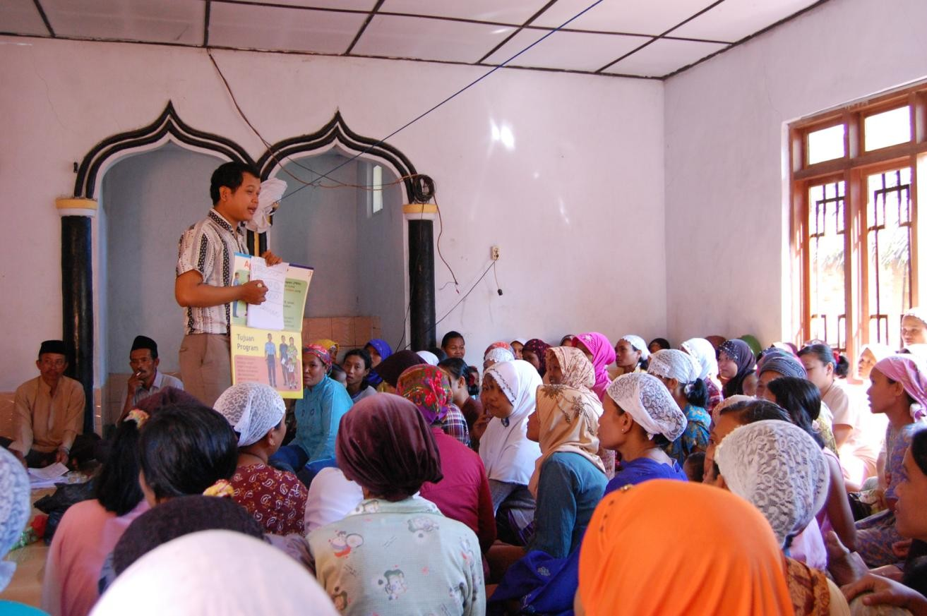
For self-targeting, a village meeting was held to explain
the CCT program

Slide 43
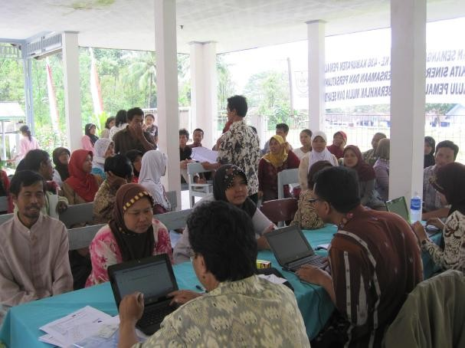
After getting a scheduled day and time, households
returned for a PMT interview

Slide 44
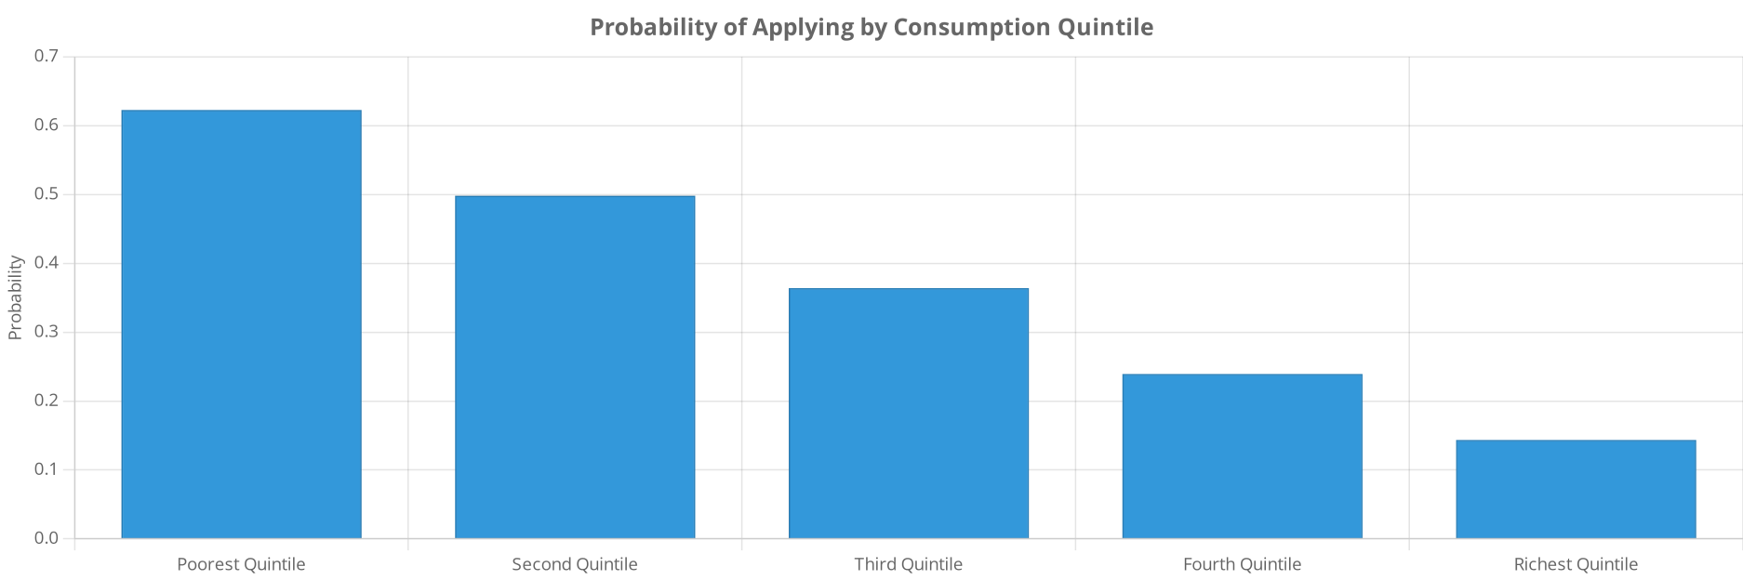
The Poor Were Significantly More Likely to Apply Than the Non-poor
Household consumption quintiles are within the baseline survey, and do not represent national consumption quintiles
Reasons for Not Applying
Key Insight

Slide 45

Non-poor Selecting Out Meant Lower Inclusion Errors in Self-targeting Areas
Control treatment revisited PPLS08 households rated as very poor (with some additional households from village officials and BPS sweeping), and conducted the same PMT interview as in self-targeting.
40
35
30
25
20
15
10
5
0
Self-targeting Benefit Incidence Compared to Control
Percent
Control
Self Targeting
1 2 3 4 5 6 7 8 9 10
Key Finding:
Self-targeting led to fewer non-poor households receiving benefits compared to the control approach.

Slide 46
Policy Implications and Future Directions

Slide 47

Context-Specific Targeting Recommendations
Targeting approaches should be tailored to specific country contexts, considering local conditions and constraints.
Key Contextual Factors
Data availability: Quality and coverage of household information systems
Implementation Principles
Pilot testing: Experiment with multiple approaches before scaling
Administrative capacity: complex targeting systems
Community structures: and institutions
Government ability to implement
Transparency: Clear communication about targeting criteria and processes
Flexibility:
Adapt methods to changing conditions and lessons learned
Strength of local social networks
Complementarity: Combine methods to leverage strengths and offset weaknesses
Poverty distribution: dispersion of poverty
Geographic concentration versus

Slide 48



Policy Implications and Recommendations
Evidence from targeting approaches across diverse contexts yields important policy implications for designing more effective, equitable, and responsive social protection systems.
Strategic Policy Recommendations Context-Specific Considerations
Embrace Hybrid Approaches Combine multiple targeting methods (e.g., geographic + PMT, or PMT + community validation) to leverage complementary strengths and mitigate individual weaknesses
Develop Dynamic Systems Implement regular recertification processes and on-demand applications to capture changes in household circumstances and reduce exclusion errors over time
Invest in Social Registries Build comprehensive, integrated social registries that cover more than just program beneficiaries to enable rapid response during crises and program adaptations
Strengthen Grievance Mechanisms Establish accessible, responsive appeals systems to correct targeting errors, enhance accountability, and build public trust in social protection programs
Low-Income Settings In contexts with limited administrative capacity and high informality, prioritize simpler targeting approaches (categorical, geographic) or self-targeting mechanisms that minimize administrative burden
Middle-Income Settings Leverage stronger administrative systems to implement more sophisticated targeting approaches (PMT, income verification) while maintaining flexibility for crisis response
Crisis-Prone Regions Develop shock-responsive targeting systems with pre-positioned registries, early warning triggers, and flexible expansion mechanisms to enable rapid response
Key Insight The most effective targeting approaches balance technical considerations with political economy factors, recognizing that public and political support is essential for program sustainability and impact.

Slide 49
Further Research Questions
Numerous targeting methods have been used in practice, and a growing empirical literature is helping us understand how to make trade-offs across them. However, several broader issues warrant careful consideration as we work to improve these systems.
Exclusion Error Problem
All targeting methods—particularly when trying to reach the extreme poor—have substantial exclusion error. How can these methods be modified to substantially eliminate this error? Can grievance mechanisms be implemented fairly to fix these challenges?
Transparency & Rights
Income-based targeting establishes clear, transparent rules and a "right" to programs. But with complex PMT formulas or community targeting, how can governments convey ex ante who has a right to a program? Can we simplify eligibility to increase transparency without sacrificing predictive power?
Static vs. Dynamic Needs
Many methods are fundamentally static—targeting is done infrequently based on long-running predictors. Yet incomes and needs can change rapidly. Adapting these methods to capture changing circumstances is crucial for future work.
Integrated Approaches
How can these methods work in concert? For example, using universal transfers in high-poverty- density neighborhoods but PMT in low-poverty-density ones. Would this reduce error? How would people view the fairness of using different methods within the same country?

Slide 50
Emerging Directions: Treatment Effects and Emergency Response
Beyond identifying low incomes, targeting can focus on households with high expected treatment effects, selecting beneficiaries who will benefit most from specific programs like graduation initiatives or preventive health subsidies.
Treatment Effect Targeting
Predicting who benefits most focuses
allocation on treatment effects, using data- driven methods to estimate heterogeneity in program impacts for interventions like preventive health or productive asset transfers. This requires careful modeling and validation
Emergency Systems
Crisis situations such as natural disasters, pandemics, or economic shocks require rapid response targeting approaches that balance speed, coverage, and accuracy under severe time and information constraints.
Anticipatory Assistance
Anticipatory targeting moves beyond reactive approaches by identifying potential beneficiaries before shocks occur, enabling faster response and better protection of vulnerable populations during crises.
Building social protection systems in normal times—identification cards, unified databases, distribution channels—improves crisis responsiveness. Countries with pre-existing systems performed better addressing poverty during the pandemic, highlighting the importance of system readiness and infrastructure investment.

Slide 51


COVID-19: Targeting in Crisis Response
The COVID-19 pandemic created unprecedented challenges for social protection systems worldwide, requiring rapid expansion of coverage and innovative targeting approaches to
reach newly vulnerable populations.
Emergency Targeting Approaches Key Lessons for Targeting
Horizontal Expansion
Countries rapidly expanded existing social registries to include newly vulnerable populations affected by economic shutdowns
Invest in Social Registries
Countries with comprehensive, up-to-date social registries were able to respond more quickly and effectively to identify and reach vulnerable populations
Dynamic Targeting Systems
Static targeting approaches failed to capture rapidly changing vulnerability; systems that could quickly reassess eligibility performed better
Digital Registration
Mobile and online platforms enabled rapid self-registration and verification for emergency assistance
Example: Togo used mobile phone metadata to target, which Aiken et al. (2022) report substantially reduced exclusion errors relative to geography-based targeting.
Inclusion-Exclusion Tradeoffs
During acute crisis, many countries prioritized speed and coverage over precision, accepting higher inclusion errors to minimize exclusion of vulnerable groups
Alternative Data Sources
Satellite imagery, mobile phone data, and utility records used to identify vulnerable households when traditional data was unavailable

Slide 52
Questions & Discussion
Questions & Answers
Thank you for participating in today's lecture

